Slide 1
Master 272 : Gestion Quantitative / Groupe 9
Xiyu Xue Arthikan Rajaratnam Joudy Benkaddour Abdoulaye Gaye

Slide 2
Pricing the Term Structure with Linear Regressions
Saturday, February 3, 2024

Slide 3
Authors: Tobias Adrian Richard K. Crump Emanuel Moench
Saturday, February 3, 2024

Slide 4
Introduction
Interest rate term structure is vital in finance, guiding decisions. The yield curve reflects market expectations on future rates.
Aﬃne models of the term structure of interest typically start with three assumptions :
the pricing kernel is exponentially aﬃne in the shocks driving the economy
prices of risk are aﬃne in the state variables
innovations to state variables and log yield observation errors are conditionally Gaussian and independent.
How to estimate coeﬃcients and pricing factors ?
Distributional assumptions & the no-arbitrage constraints => MLL
Notes:
These assumptions give rise to log yields that are aﬃne in the state variables, and whose coeﬃcients on the state variables are subject to no-arbitrage constraints across maturities.
Empirically, the aﬃne term structure literature commonly uses maximum likelihood methods to estimate coeﬃcients and pricing factors, thus exploiting the distributional assumptions as well as the no-arbitrage constraints. In this paper, we propose an alternative, regression-based approach to pricing the time series and cross section of interest rates.

Slide 5
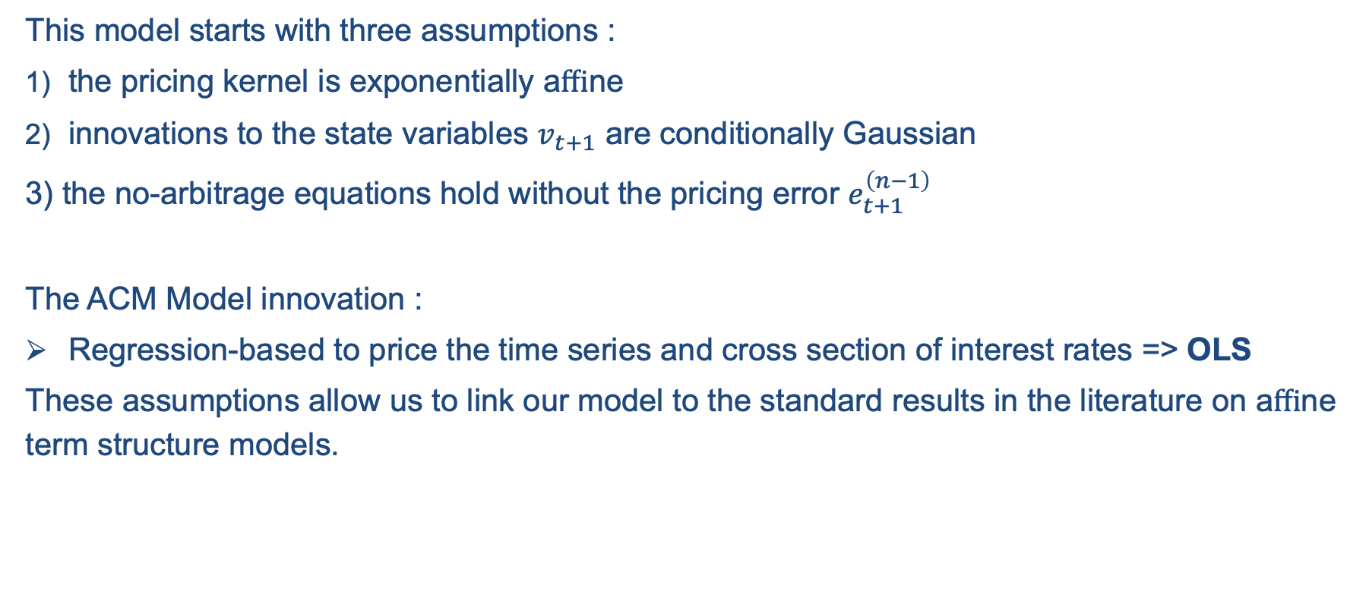
Introduction – The ACM Model
This model starts with three assumptions :
the pricing kernel is exponentially aﬃne
innovations to the state variables $v_{t+1}$ are conditionally Gaussian
3) the no-arbitrage equations hold without the pricing error $e_{t+1}^{\left(n−1\right)}$
The ACM Model innovation :
Regression-based to price the time series and cross section of interest rates => OLS
These assumptions allow us to link our model to the standard results in the literature on aﬃne term structure models.
Notes:
These assumptions give rise to log yields that are aﬃne in the state variables, and whose coeﬃcients on the state variables are subject to no-arbitrage constraints across maturities.
Empirically, the aﬃne term structure literature commonly uses maximum likelihood methods to estimate coeﬃcients and pricing factors, thus exploiting the distributional assumptions as well as the no-arbitrage constraints. In this paper, we propose an alternative, regression-based approach to pricing the time series and cross section of interest rates.

Slide 6
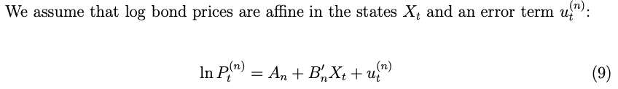
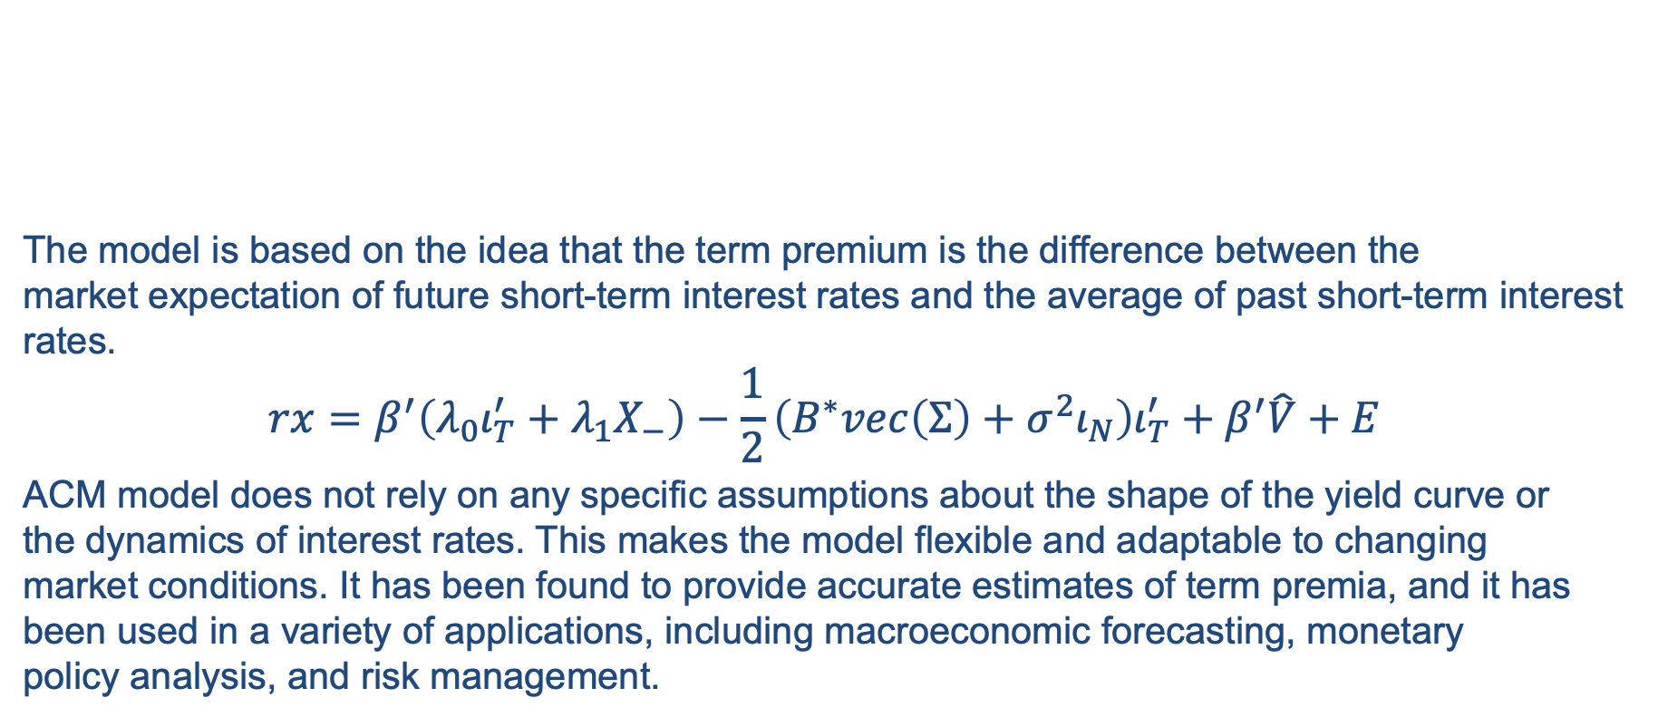
Introduction – The ACM Model
The model is based on the idea that the term premium is the difference between the market expectation of future short-term interest rates and the average of past short-term interest rates.​
$$rx=β^{′}\left(λ_{0}ι_{T}^{′}+λ_{1}X_{−}\right)−\frac{1}{2}\left(B^{∗}vec\left(Σ\right)+σ^{2}ι_{N}\right)ι_{T}^{′}+β^{′}\hat{V}+E$$
ACM model does not rely on any specific assumptions about the shape of the yield curve or the dynamics of interest rates. This makes the model flexible and adaptable to changing market conditions. It has been found to provide accurate estimates of term premia, and it has been used in a variety of applications, including macroeconomic forecasting, monetary policy analysis, and risk management.

Slide 7
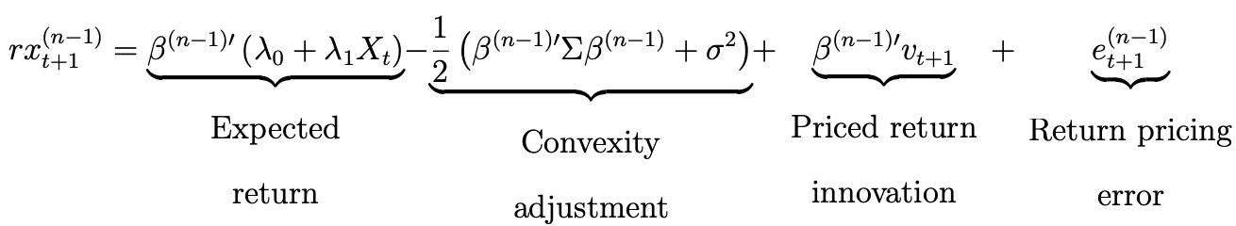
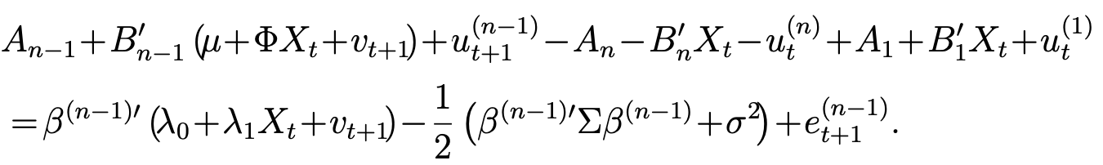
Introduction – The ACM Model

Slide 8
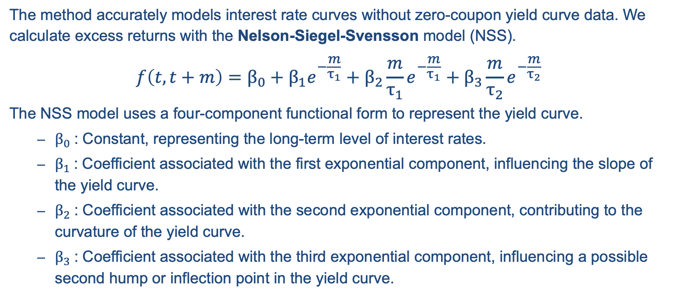
Introduction – NSS Model
The method accurately models interest rate curves without zero-coupon yield curve data. We calculate excess returns with the Nelson-Siegel-Svensson model (NSS).
$$f\left(t,t+m\right)=β_{0}+β_{1}e^{−\frac{m}{τ_{1}}}+β_{2}\frac{m}{τ_{1}}e^{−\frac{m}{τ_{1}}}+β_{3}\frac{m}{τ_{2}}e^{−\frac{m}{τ_{2}}}$$
The NSS model uses a four-component functional form to represent the yield curve.
$β_{0}$: Constant, representing the long-term level of interest rates.
$β_{1}$: Coefficient associated with the first exponential component, influencing the slope of the yield curve.
$β_{2}$: Coefficient associated with the second exponential component, contributing to the curvature of the yield curve.
$β_{3}$: Coefficient associated with the third exponential component, influencing a possible second hump or inflection point in the yield curve.

Slide 9
Introduction – GSW dataset
The Gurkaynak, Sack, and Wright (2006) paper, titled "The U.S. Treasury Yield Curve: 1961 to the Present" examines the behavior of the U.S. Treasury yield curve.
They find that the changes in the slope of the yield curve are informative about changes in monetary policy. They also find evidence of a positive inflation risk premium, meaning that investors demand higher compensation for inflation risk, and a positive real interest rate, meaning that investors demand compensation for the opportunity cost of holding bonds.
They estimated in the paper parameters of the NSS model by minimizing the discrepancy between the fitted NSS yield curve and observed market yields. Following their work, the Fed reports fitting results of NSS model in the GSW dataset.

Slide 10
I. Data and variables preparation

Slide 11
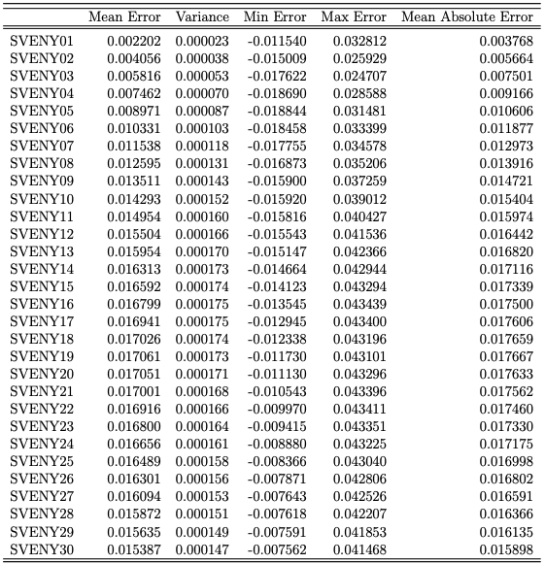
Table 1 : Comparison of GSW yields over NSS yields for maturities up to thirty months
I. Data and variables preparation
To begin, we transform the GSW database using the Nelson-Siegel-Svensson formula on Python. This involves generating cross-sections of bond yields with varying maturities.
Next, we create a log-return dataset, condensing observations. The first column represents the risk-free return so the one-month yield.

Slide 12
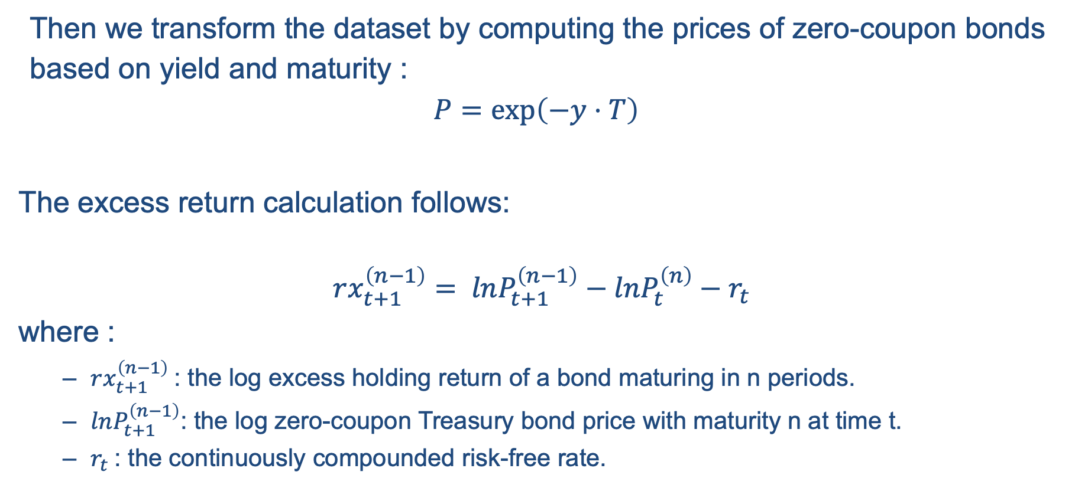
Calculation of the price, risk-free return, and excess return dataframes
I. Data and variables preparation
Then we transform the dataset by computing the prices of zero-coupon bonds based on yield and maturity :
$$P=\exp\left(−y⋅T\right)$$
The excess return calculation follows:
$$rx_{t+1}^{\left(n−1\right)}= lnP_{t+1}^{\left(n−1\right)}−lnP_{t}^{\left(n\right)}−r_{t}$$
where :
$rx_{t+1}^{\left(n−1\right)}$: the log excess holding return of a bond maturing in n periods.
$lnP_{t+1}^{\left(n−1\right)}$: the log zero-coupon Treasury bond price with maturity n at time t.
$r_{t}$: the continuously compounded risk-free rate.

Slide 13
Factor Extraction
I. Data and variables preparation
« A factor must be persistant over time, persuasive accross market, robust to different definition, intuitive to common sense and investable at reasonable cost. »
Dimson, 2017

Slide 14
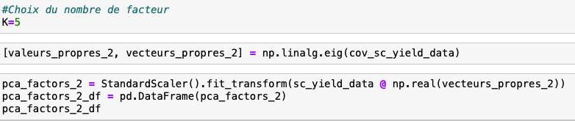
Factor Extraction
I. Data and variables preparation
PCA transforms correlated variables into uncorrelated ones, called "principal components". It brings us the maximum variance for a minimum variable, it thus reduces the dimension of the problem.
We scale the data. The variance-covariance matrix of scaled returns is diagonalizable, allowing extraction of eigenvectors and eigenvalues.
Principal components are derived by centering and normalizing the product of standardized returns and eigenvectors. These components represent our factors.

Slide 15
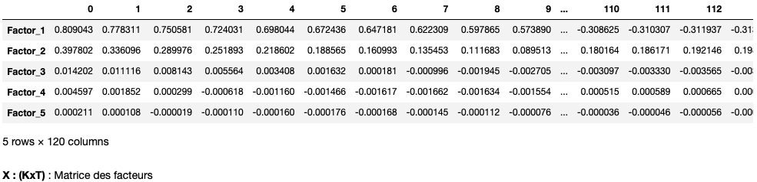
Factor Extraction
I. Data and variables preparation
In summary, PCA effectively captures dataset variance with 5 components.

Slide 16
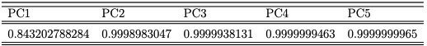
Table 2 : Variance explanation as a function of the number of principal components
I. Data and variables preparation

Slide 17
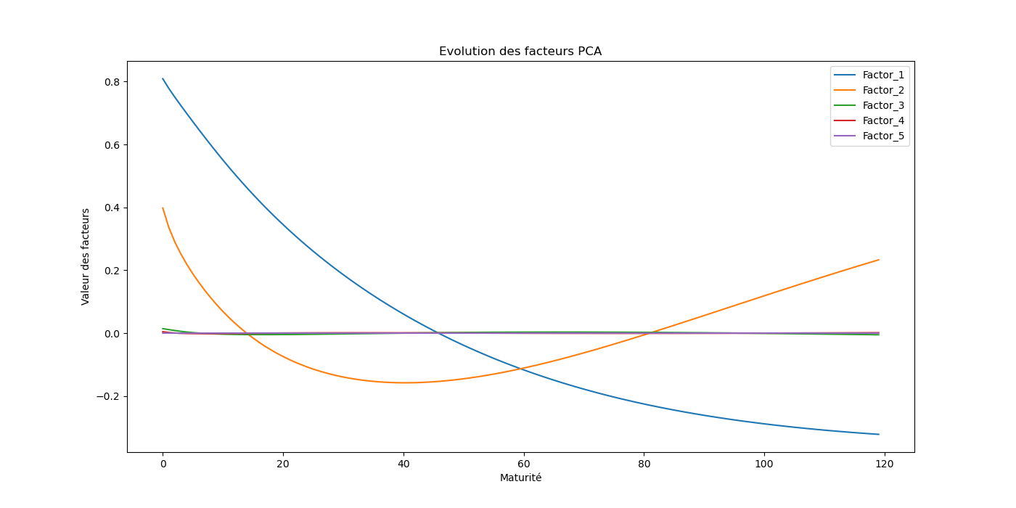
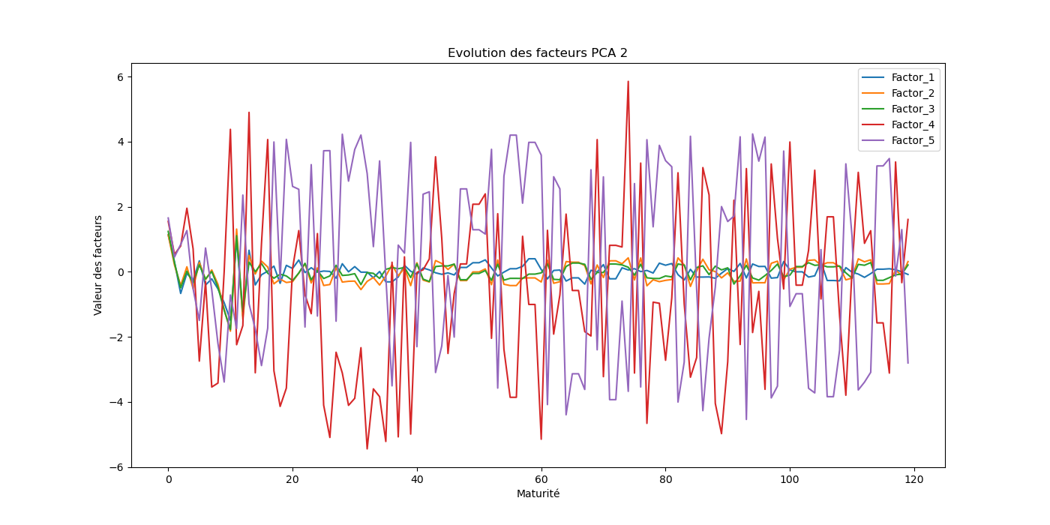
I. Data and variables preparation
Figure 1 : Factors’ evolution across maturities
Figure 2 : Factor’s evolution across maturities by centering and normalizing the product of the matrix of standardized returns by the eigenvectors of the covariance matrix of standardized returns

Slide 18
II. Explanation of the Estimation Procedure

Slide 19
Step 1 : Factor regression

Slide 20
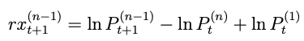
Model Estimation : 3-Step Approach
II. Explanation of the Estimation Procedure
Hence :

Slide 21
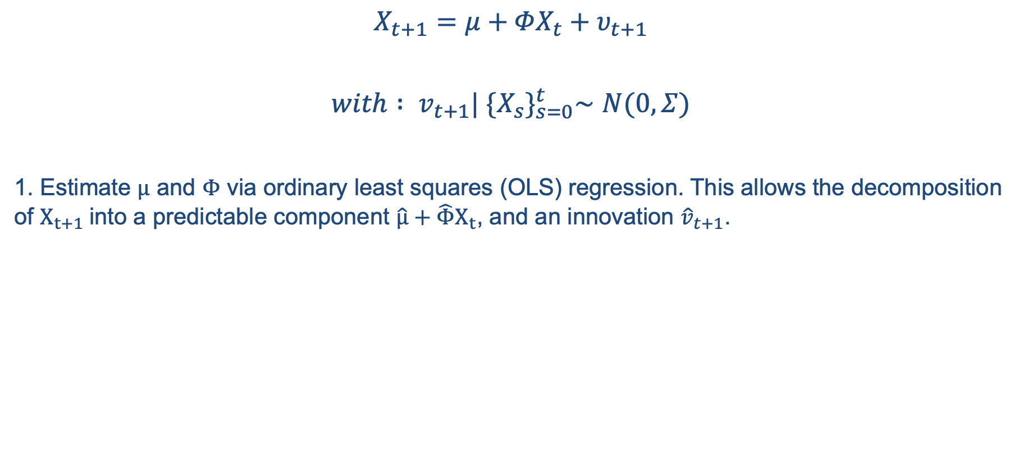
Model Estimation : 3-Step Approach
II. Explanation of the Estimation Procedure
$$X_{t+1}=μ+ΦX_{t}+υ_{t+1}$$
$with : v_{t+1}| {\{X_{s}\}}_{s=0}^{t}∼N(0, Σ)$
1. Estimate $μ$ and $Φ$ via ordinary least squares (OLS) regression. This allows the decomposition of $X_{t+1}$into a predictable component $\hat{μ}+\hat{Φ}X_{t}$, and an innovation ${\hat{v}}_{t+1}$.

Slide 22
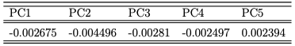
Table 3 : Mu values
II. Explanation of the Estimation Procedure

Slide 23
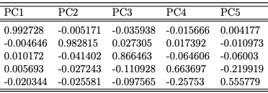
Table 4 : Phi values
II. Explanation of the Estimation Procedure

Slide 24
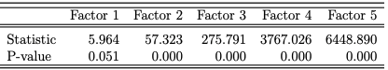
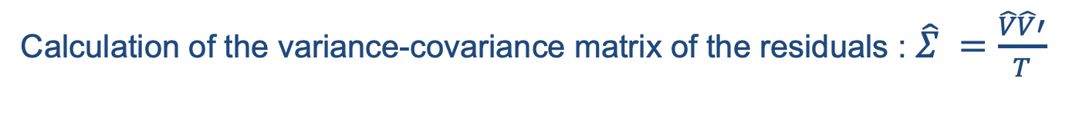
Table 5 : Jarque and Bera test over the residuals
II. Explanation of the Estimation Procedure
Calculation of the variance-covariance matrix of the residuals : $\hat{Σ} =\frac{\hat{V}\hat{V}′}{T}$

Slide 25
Step 2 : Regression of the excess return

Slide 26
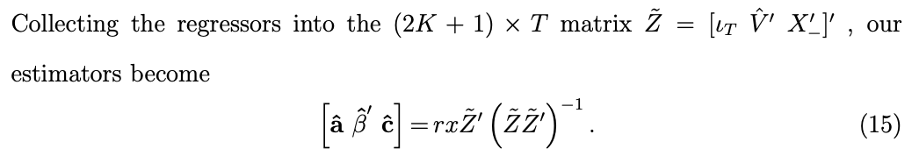
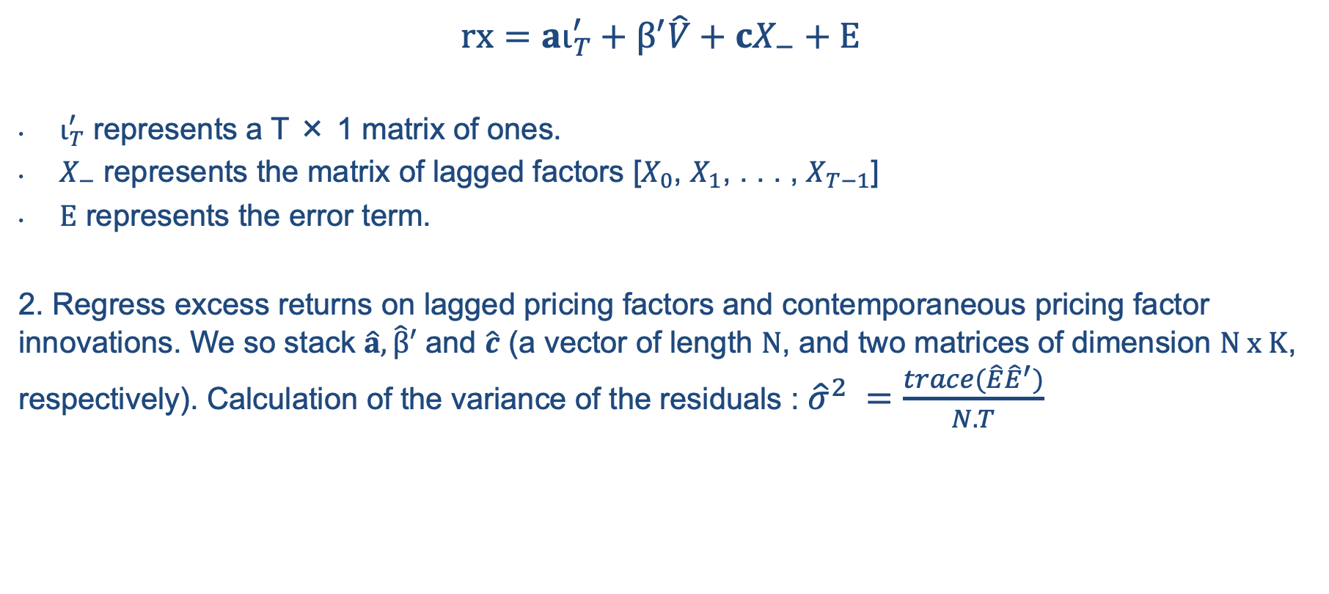
Model Estimation : 3-Step Approach
II. Explanation of the Estimation Procedure
$$rx=aι_{T}^{′}+β^{′}\hat{V}+cX_{−}+E$$
$ι_{T}^{′}$ represents a T × 1 matrix of ones.
$X_{−}$ represents the matrix of lagged factors [$X_{0}$, $X_{1}$, . . . , $X_{T−1}$]
$E$ represents the error term.
2. Regress excess returns on lagged pricing factors and contemporaneous pricing factor innovations. We so stack $\hat{a},\hat{β}′$ and $\hat{c}$ (a vector of length $N$, and two matrices of dimension $N x K$, respectively). Calculation of the variance of the residuals : ${\hat{σ}}^{2} =\frac{trace(\hat{E}{\hat{E}}^{′})}{N.T}$

Slide 27
Step 3 : Estimation of market parameters

Slide 28
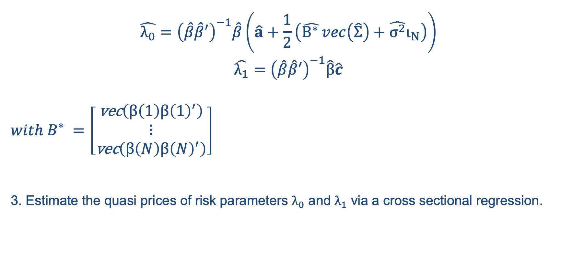
Model Estimation : 3-Step Approach
II. Explanation of the Estimation Procedure
$$\hat{λ_{0}}={\left(\hat{β}\hat{β}′\right)}^{−1}\hat{β}\left(\hat{a}+\frac{1}{2}\left(\hat{B^{∗} }vec\left(\hat{Σ}\right)+\hat{σ^{2}}ι_{N}\right)\right)$$
$$\hat{λ_{1}}={\left(\hat{β}\hat{β}′\right)}^{−1}\hat{β}\hat{c}$$
$with B^{∗} =\left[\begin{aligned}\text{vec}\left(β\left(1\right)β{\left(1\right)}^{′}\right) \\ ⋮ \\ \text{vec}\left(β\left(N\right)β{\left(N\right)}^{′}\right)\end{aligned}\right]$
3. Estimate the quasi prices of risk parameters $λ_{0}$ and $λ_{1}$ via a cross sectional regression.

Slide 29
Iteration

Slide 30
Model Estimation : 3-Step Approach
II. Explanation of the Estimation Procedure

Slide 31
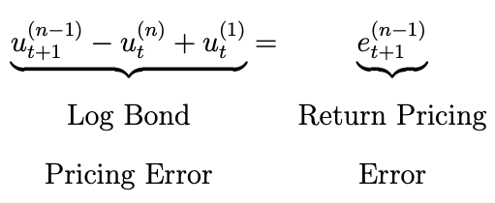
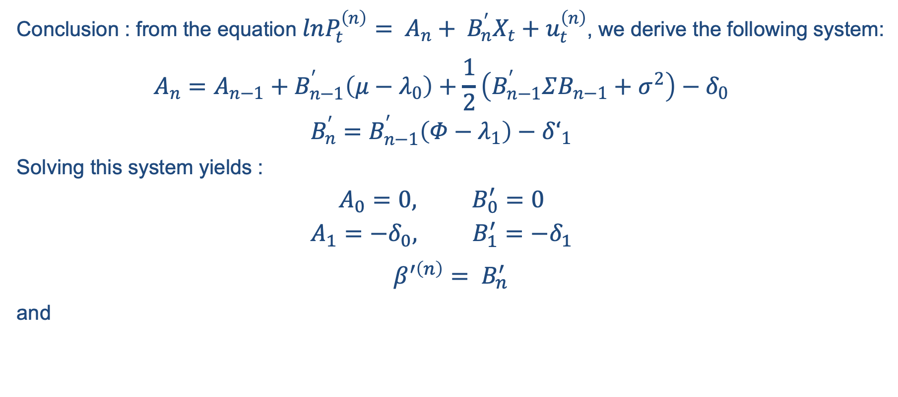

Model Estimation : 3-Step Approach
II. Explanation of the Estimation Procedure
Conclusion : from the equation $lnP_{t}^{\left(n\right)}= A_{n}+ B_{n}^{′}X_{t}+u_{t}^{\left(n\right)}$, we derive the following system:
$$A_{n}=A_{n−1}+B_{n−1}^{′}\left(μ−λ_{0}\right)+\frac{1}{2}\left(B_{n−1}^{′}ΣB_{n−1}+σ^{2}\right)−δ_{0}$$
$$B_{n}^{′}=B_{n−1}^{′}\left(Φ−λ_{1}\right)−δ‘_{1}$$
Solving this system yields :
$$A_{0}=0, B_{0}^{′}=0$$
$$A_{1}=−δ_{0}, B_{1}^{′}=−δ_{1}$$
$β^{′\left(n\right)}= B_{n}^{′}$
and
$rf=δ_{0}$+ $δ_{1}X+ℇ.$

Slide 32
III. Results

Slide 33
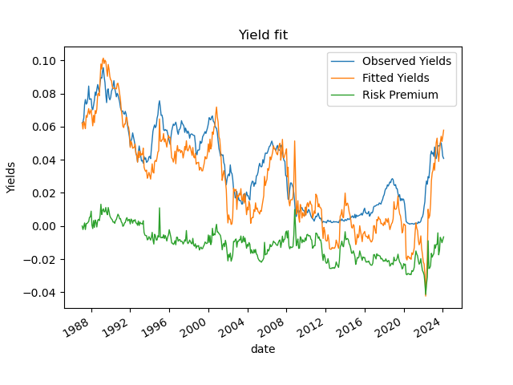
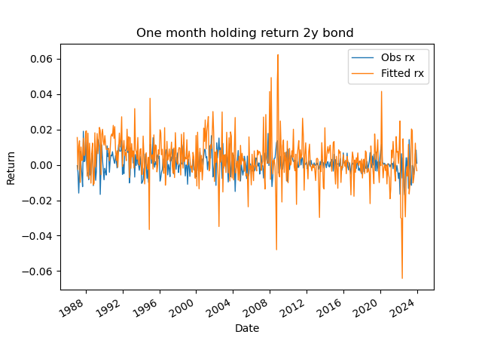
Figure 3 : Time series of observed and fitted yields and one month holding for the two-year bond
III. Results

Slide 34
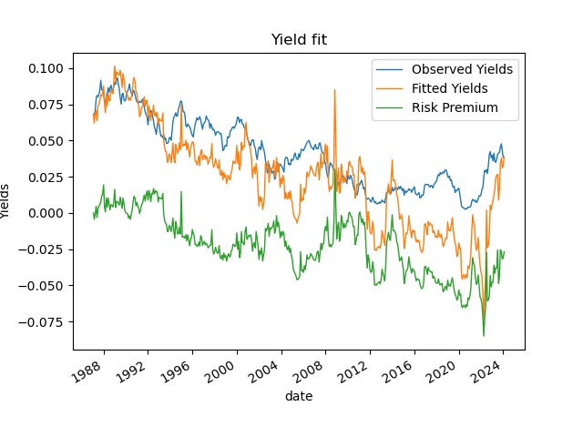
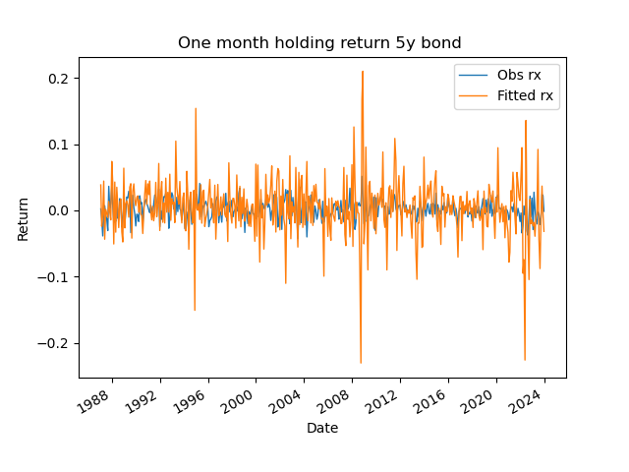
Figure 4 : Time series of observed and fitted yields and one month holding for the five-year bond
III. Results

Slide 35
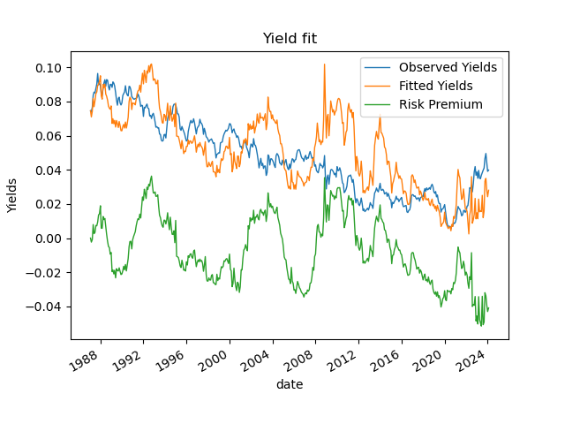
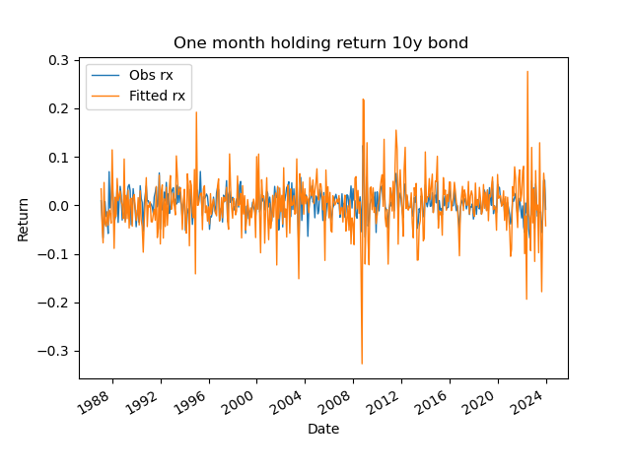
Figure 5 : Time series of observed and fitted yields and one month holding for the ten-year bond
III. Results

Slide 36
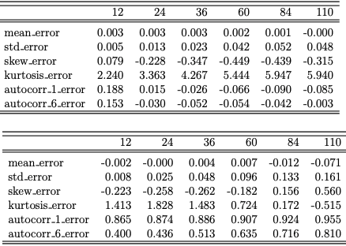
Table 6: Return pricing errors vs. Yield pricing errors
III. Results
This table depicts characteristics of yield pricing errors and yield pricing errors accross maturities

Slide 37
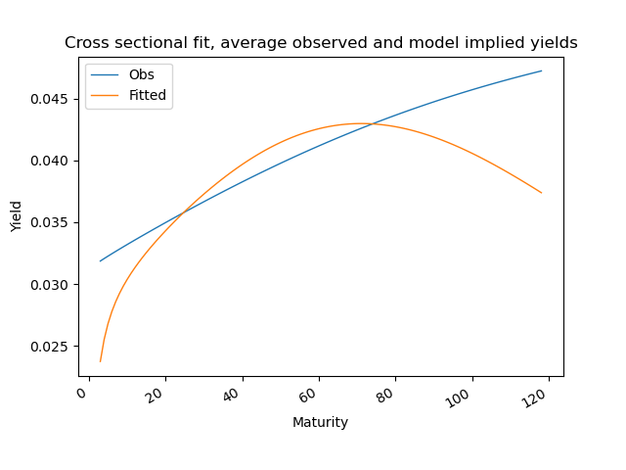
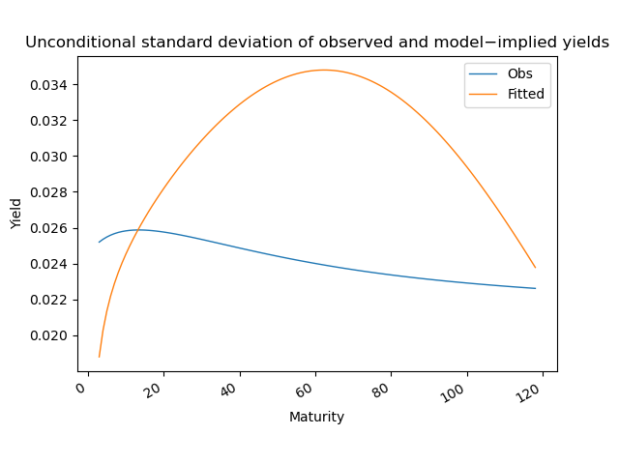
III. Results
Figure 6 : Average yields
Figure 7 : Unconditional standard deviation of yields

Slide 38
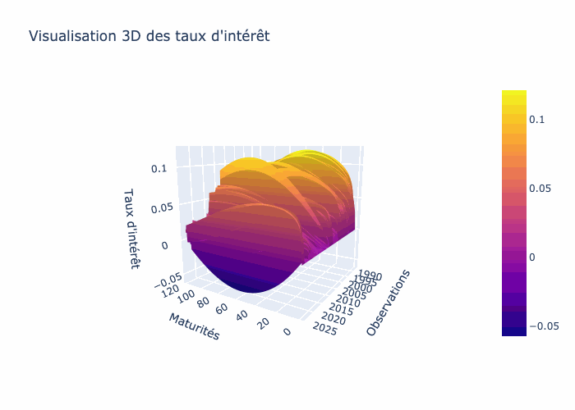
Figure 8 : 3D View of Interest Rates
III. Results

Slide 39
IV. Extension

Slide 40
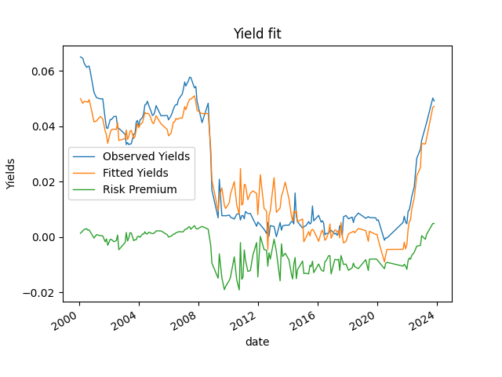
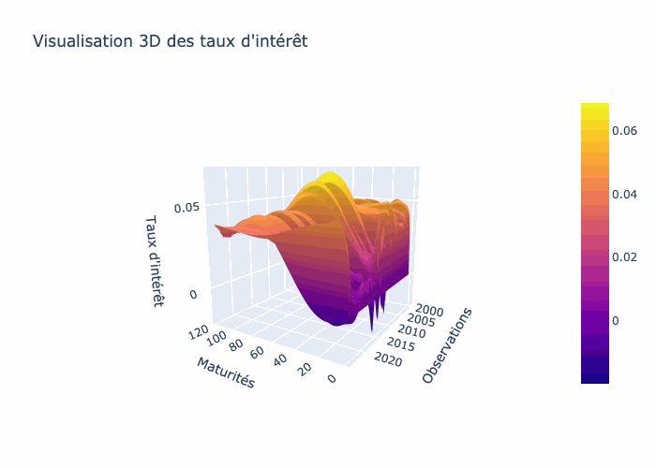
Figure 9 : UK Zero Coupon Yields 1Y & 3D View of Interest Rates
IV. Extension

Slide 41
Merci de votre attention
Master 272 : Gestion Quantitative / Groupe 9

